Slide 1
HMBS Placement Ready Information Session
Meet your compliance requirements and get placement-ready

Slide 2


Acknowledgement of Country
The University of Queensland (UQ) acknowledges the Traditional Owners and their custodianship of the lands on which we meet.
We pay our respects to their Ancestors and their descendants, who continue cultural and spiritual connections to Country.
We recognise their valuable contributions to
Australian and global society.
The Brisbane River pattern from A Guidance Through Time
by Casey Coolwell and Kyra Mancktelow.

Slide 3
Your Placement Support Teams
There are three main support teams to assist you with preparing and completing your placements
HMBS Placement Ready Team
Communicate with students participating in WIL about what requirements they need to complete.
Verify student compliance submissions (except immunisations).
Answer queries from students about compliance requirements.
Send reminders to students for
documentation.
Send compliance reports to Schools
Immunisation Record Team (IRT)
Verify student immunisation compliance
submissions
Answer queries from students about immunisation requirements.
Advise students on next steps regarding their immunisation requirements
IRT are the only ones that can access and
view your immunisation evidence.
Email: immunisation@uq.edu.au
School Placement Management
Team
Coordinate and manage placements for students
Communicate directly with providers regarding placement schedule and content
Decide if students can attend placement or
remove students from placement
Manage student absences on placement
Manage the assessment for students and completion of placements.

Slide 4
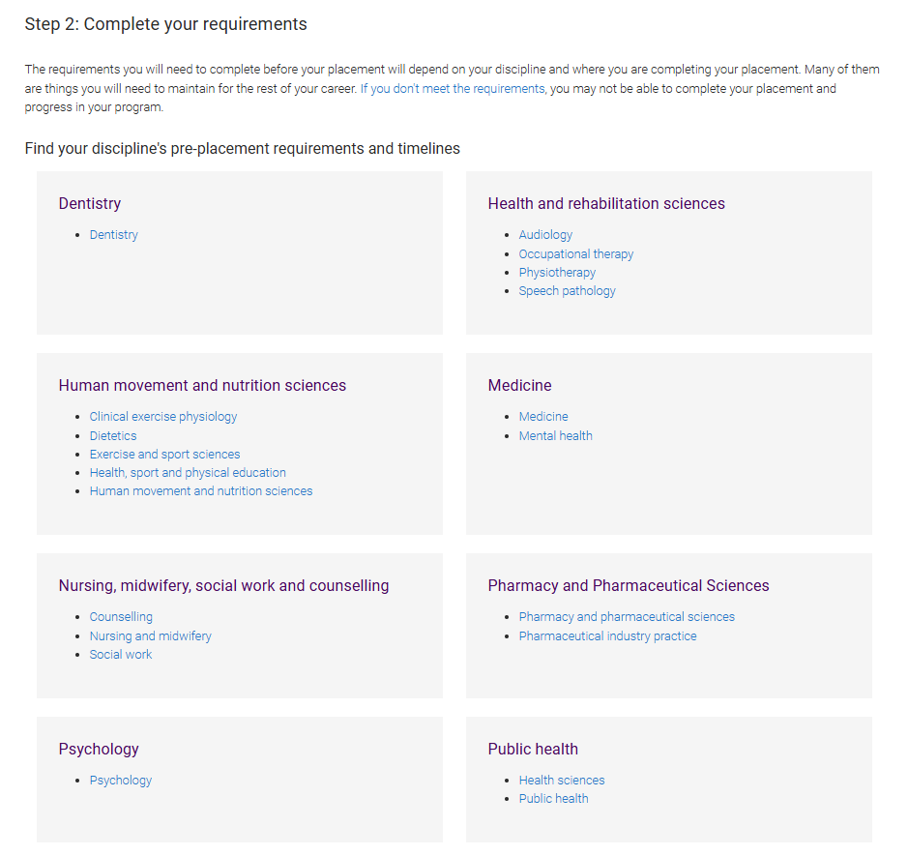
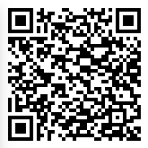
Requirements and due dates by Discipline
To check what the specific requirements are for your program or discipline, look for your box listing your school on the Prepare for your HMBS Placement page on my.UQ.
The HMBS Placement Ready Team will also be communicating with each cohort regarding requirements and reminders about expiring documentation, so please ensure that you check your student email account regularly.

Slide 5

The Student Immunisation Evidence Record process:
Student accesses request from my.UQ and print form to take to GP (Form A – Allied Health; Form B – Dentistry, Nursing, Midwifery, Medicine)
Student to complete Tuberculosis Risk Assessment Form
Student completes follow-up requirements if requested by Immunisation Record Team
General Medical Practitioner to complete Immunisation Record
Student uploads both completed forms to my.UQ using link provided in email/request.

Slide 6
The Student Immunisation Evidence Record process:
You will be sent a Student Immunisation Evidence Request via my.UQ and receive an email with a link to submit your Student Immunisation Record form.
Ask your GP to complete the Student Immunisation Record
  Form A: Low Risk OR;
  Form B: High Risk (only applicable to Nursing, Midwifery, Dentistry and Medicine students)
Complete the TB risk assessment form yourself and submit it with your immunisation record form.
Your Immunisation forms are processed by the UQ Immunisation Record Team (IRT), and they will leave comments in the request and send you an email if any requirements are outstanding.
If you have completed 2 doses of your Hep B vaccination schedule you are able to attend placement conditionally until you upload an updated form including
your 3rd dose date and/or your serology results.
If IRT determine that you require further TB testing, you are able to attend placement conditionally until you upload evidence from your test confirming your clear status.
IMPORTANT!! Conditional status is temporary and will expire within 6 months after the original deadline.
If you have questions specific to your immunisation requirements, please ask in the comments section of your request or contact the
Immunisation Record Team (IRT) via immunisation@uq.edu.au.
You can also find answers to commonly asked questions via UQ Answers

Slide 7
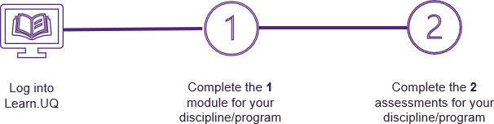
HMBS Placement Preparation Module (Blackboard Essentials)
These modules are different to the iLearn Modules and must
be completed by ALL HMBS students.
Please follow the instructions on the Placement Preparation Module webpage to complete the module via Blackboard Essentials.
Once you have completed the module, the HMBS Placement Ready Team will be able to confirm your completion in Blackboard Essentials, so there is no need to upload evidence of this requirement to InPlace.
You must pass with 80% to register as completing the assessment.
Remember: the HMBS Placement Preparation Module are different to the iLearn modules.
*Not required for School of Medicine and School of Public Health students
Discipline(s) | Module
All Social Work M Counselling B Health, Sport and Physical Education B Human Movement & Nutrition Science B Psychological Science M Business Psychology M Organisational Psychology M Pharmaceutical Industry Practice | HMBS – Placement Preparation
All other HMBS disciplines/programs* | HMBS – Clinical Placement Preparation

Slide 8
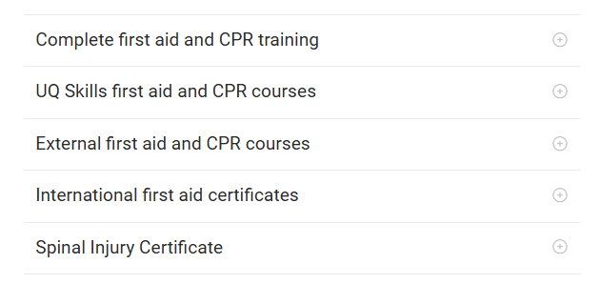
First Aid and CPR
Tips to remember:
First Aid (HLTAID011) certificates are valid for 3 years. *First Aid courses include CPR.
CPR (HLTAID009) certificates are valid for 1 year.
Courses must be completed through a Registered Training Organisation.
If you have completed a course overseas, you must provide evidence to show it has covered the same requirements.
Onsite training with UQ Skills:
UQ Skills runs courses throughout the year at St Lucia
COST: $120 for First Aid, $69 for CPR refresher.
Information and registration on the First Aid and CPR webpage.

Slide 9
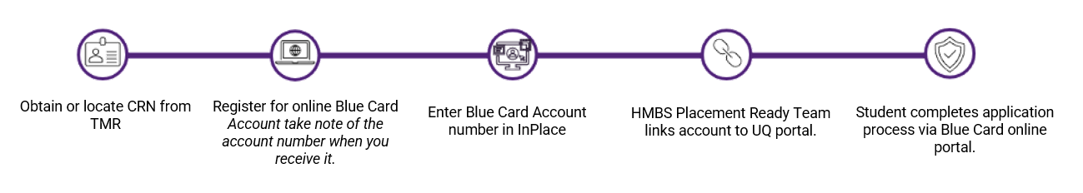
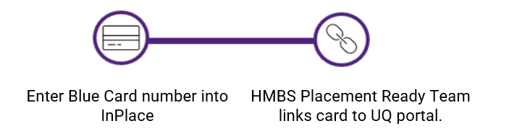
Blue Card (Working with Children Check or WWCC)
How to apply for a Blue Card:
How to link an existing Blue Card (volunteer or paid):
No Card, No Start – If you do not have a valid Blue Card you cannot be on placement, this is a QLD government policy.
Please see the Working with children check (Blue Card) webpage for details about the process of applying for a card or linking a card.
Blue Cards are valid for 3 years.
It is an offense to apply for a Blue Card if you are a disqualified person.

Slide 10
National Police Certificate
Tips for your NPC application:
The name on your certificate must be the same as listed on mySi-Net.
Police certificates are valid for 3 years. Your certificate must have at least 6 months validity when you submit to InPlace. (Some providers also may ask for an NPC that is conducted no earlier than 6mths prior to your placement start date). Costs may vary between $40 - $60.
The quickest way to obtain one is online via Australian Federal Police If you are an international student applying overseas, the AFP now allow online application with digital certificates, so this is your best option. (When applying with either provider, you should select the option to also receive a paper copy in case your allocated provider does not accept digital copies).
•
WE DO NOT ACCEPT CERTIFICATES FROM QUEENSLAND POLICE. Due to UQ’s inability to maintain student privacy when verifying the check.
IF you are asked to select a purpose for your NPC application, you should select an option that includes ‘aged care volunteer’ even if your placement isn’t taking place in an
aged care facility as this will cover you for a range of different placement types.
If you are convicted of any offence during the 3-year NPC expiry period, you MUST notify your Placement Coordinator immediately.
If you have been a citizen or permanent resident of a country other than Australia after the age of 16 you must also complete a Criminal History Statutory Declaration.

Slide 11
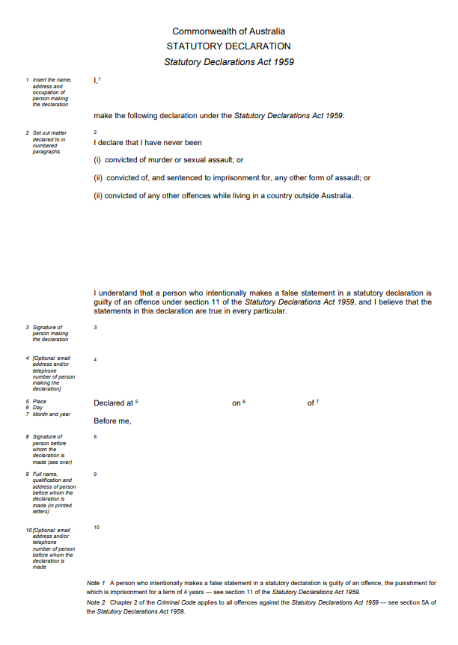
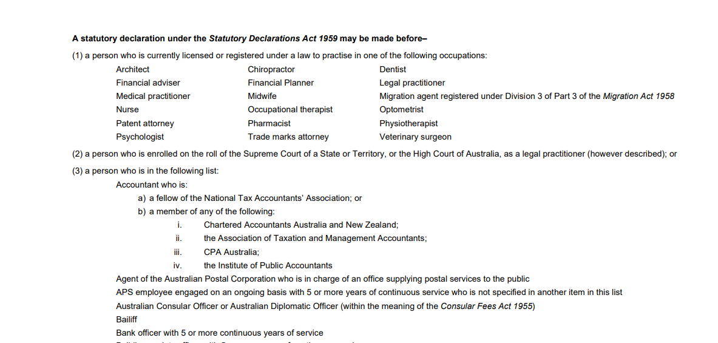
Statutory Declaration
Tips for your Statutory Declaration:
If you have been a citizen or permanent resident of a country other than Australia after the age of 16 you must also complete a Criminal History Statutory Declaration.
The form must be printed, signed and witnessed in person, not digitally.
The witness must have an approved occupation or position as per the list on the reverse page of the statutory declaration and must have a provable connection to Australia (registered to practise in Australia etc).
The form is a Commonwealth legal document, providing fraudulent information on this form is a federal offense.
The only version of the statutory declaration that is accepted by the University.
List of approved witnesses on page 2 and 3 of the form.

Slide 12
QLD Health requirements
Student Deed Poll
Student Orientation Checklist
Record of Allied Health Student Training
Not required to be submitted to InPlace
Make sure you have read and understand the Orientation Checklist and remember to:
If your discipline is an allied health field, you will be required to complete some additional training modules.
Sign and Print it for presentation to QLD Health on the first day of your placement.
Upload the first 3 pages of the document.
Upload your Record form to InPlace, indicating any completed iLearn modules. Some modules can be completed prior to placement, and others must be completed upon commencement with your placement provider.
Ensure you select the relevant HHS to your placement
A new Student Deed Poll is required for each new placement.
Ensure you upload the latest version (and that the
document version is clearly visible).
Tick all relevant boxes showing completion and understanding of information provided on the form.
Please see further information about Record of Allied Health Student Training and the additional training modules that are required, on our website.
Include all relevant date of check and/or expiry dates in the legal check section.
There is one module that requires annual renewal, Child Abuse & Neglect. Please submit the form noting the completion date and refresher date.
Upload ALL pages of the document, even if they
are not completed.

Slide 13
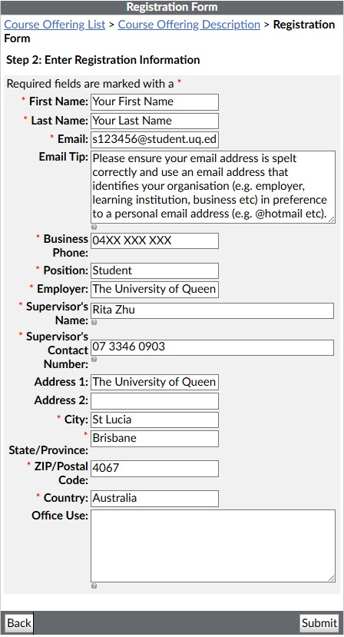



Registering for your QLD Health iLearn Modules
Application time: It can take up to 3 days for your iLearn account to be activated. The mandatory training modules take at least 2 hours to complete.
Please ensure your email is in the format: s1234567@student.uq.edu.au
Please input the following details for your supervisor:
Supervisor's name: Rita Zhu
Supervisor's contact number: 07 3346 0903
Take note of your password as you may need this in the future.
If you have any issues you will need to contact QLD Health ITS or the iLearn Help Desk at 1800 198 175

Slide 14
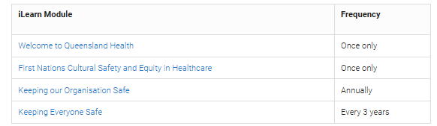
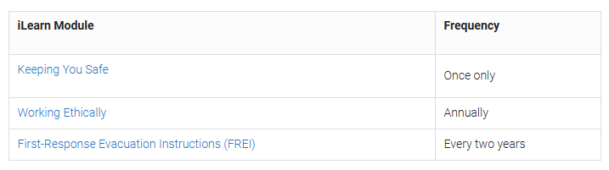
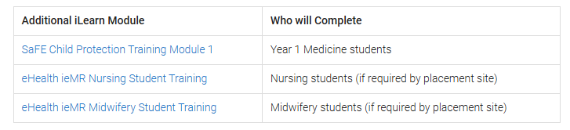
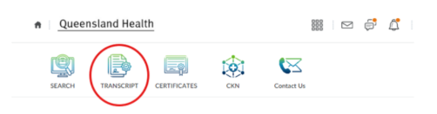
QLD Health iLearn Modules
ILearn Modules
Students complete the mandatory modules covered by legislation only, which are listed on our website.
All students attending placement at QLD Health for >90 days must complete the following:
All students attending placement at QLD Health must complete the following:
Medicine, Nursing and Midwifery students may complete the following:
Download your transcript from iLearn and submit to InPlace.

Slide 15


National Hand Hygiene Initiative (NHHI) Modules
All Medicine, Nursing and Midwifery students are required to complete the NHHI Modules. Allied Health students attending Queensland Health placements are required to complete these modules as outlined on the Record of allied health student training form. NOTE: Not required for Dentistry students.
Register for an NHHI account and complete the following modules:
1. Hand hygiene for clinical healthcare workers
2. Basics of infection prevention and control orientation
Download both certificates and upload to InPlace in ONE file.

Slide 16
Disability Worker Screening Clearance (DWSC/Yellow Card)
The Disability Worker Screening Clearance (DWSC/Yellow Card) is required for placements within the Department of Communities, Disability Services and Seniors funded non-government service provider or a National Disability Insurance Scheme (NDIS) non- government service provider. You will be informed if your placement provider requires you to obtain a DWSC/Yellow Card.
If you have been told you need to have completed a Disability Worker Screening, please follow the steps on our webpage on how to apply.
You will not be able to commence placement until after you have received a DWSC or a yellow card exemption.
Please contact your School Placement Coordinator if you require assistance liaising with your placement or service provider regarding the DWSC requirement.

Slide 17
N95 Mask Fit Testing
Due to fluctuating cases of COVID-19 in the community, some settings require students to wear additional PPE including P2/N95 masks.
These increased PPE requirements include the need to be fit tested for an P2/N95 mask prior to commencement of clinical placements in a Qld Health, Mater Health, IUIH or Uniting Health Care facility.
More information is available to students via the Mask Fit Testing web page
You will be sent information to your student email account about when and where you need to complete your N95 fit testing. Please check your email regularly and action requests related to N95 Fit testing as soon as received.
You may also need to provide proof to your placement provider that you have been fit tested. Once you have completed your fit test, you will be provided with fit test evidence via email. You can present this evidence to your placement provider when you commence your placement.

Slide 18
Traveller declaration
Domestic Travel (within Australia)
Students who will travel more than 50km from their home and require an overnight stay for their placement are recommended to complete an online travel declaration.
They should also register with ISOS (for domestic and international travel).
International Travel
Students who will travel outside of Australia for their placement MUST complete a Student International Travel Declaration. They must also register with ISOS (for domestic and international travel).

Slide 19
Program-specific requirements
Dentistry, Nursing and Midwifery students are required to submit the Exposure Prone Procedures (EPP) Statement 3 years after submission of the Immunisation Record. The HMBS Placement Ready Team will initiate a new immunisation task via my.UQ at this point. Dentistry & Midwifery students must renew it every 3 years.
Postgraduate students may be required to submit evidence of their AHPRA Registration, and renewal on an annual basis.
Undergraduate Pharmacy (Yr3) will be required to submit evidence of Anaphylaxis training prior to commencing Yr3 placements.

Slide 20
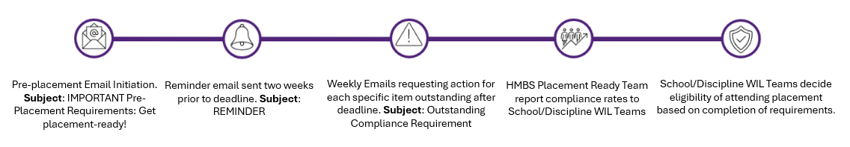
How to submit your pre-placement requirements
InPlace
Most of your compliance documentation will need to be uploaded to InPlace for verification by the HMBS Placement Ready Team. Before you can access InPlace, you must be enrolled in your placement course. Please watch the video tutorial on our website for information about how to navigate InPlace and submit your documents.
Please note: Not all compliance requirements are submitted via InPlace. You should review your discipline’s pre-placement
requirements to determine what you need to do and when.
my.UQ
If you are required to provide immunisation/medical evidence for your placement, a request will appear in the “My Requests” tab on the left of your my.UQ dashboard. This request is a secure location to upload confidential medical evidence for verification by the Immunisation Record Team.
Communication from the HMBS Placement Ready Team

Slide 21

Top Tips to becoming compliant
Check your student email account
Make sure you check InPlace regularly.
Get started on completing your Immunisation Record.
Upload ALL pages of your documents as one file to InPlace and my.UQ.
Even if you only enter information on one page you need to submit the entire document.
This is important as we will send you important updates via this account.
Forward your student email to a non-UQ account if you prefer.
If your submission has been ‘Rejected’ a comment will be left as to why and a notification
will display in the ‘To Do’ section of your InPlace homepage. If you click the ‘Read more’ link it will detail the comments.
You should get started on completing your Form A or Form B Immunisation record
immediately with your GP. You will receive a Student Immunisation Evidence Request email to upload your form into my.UQ.

Slide 22
Having trouble scanning documents?
If you do not have access to a scanner, you can use the following resources to help you upload your documentation:
UQ Libraries
Adobe Scan (free from Play or App Store)
iPhone/iPad iPodtouch Notes
Google Drive

Slide 23

Your Personal Safety on Placement
Your safety on placement, including when you are travelling to and from your placement, is one of UQ’s highest priorities.
However, you also have a responsibility to prioritise your own personal safety.
Emergency Services (Police, Fire, Ambulance) | Phone: 000 Triple Zero
UQ Student Support Services | Counselling, crisis support, financial hardship assistance, accommodation, international student support, Allianz Care
Student counselling services | UQ offers a range of different counselling sessions to suit your needs including one- on-one appointments, group sessions and online support. If you need assistance outside normal business hours, please call our UQ Counselling and Crisis Line: 1300 851 998
Sexual Misconduct Support Unit | The University of Queensland's Sexual Misconduct Support Unit is a safe and supportive place for the UQ community to receive guidance around sexual assault and misconduct.
First responder network | The First Responder Network offers a safe and supportive environment so that you can receive information on the support services that are available to you. Note: The First Responder Network is not an emergency response or counselling service
UQ Security | Keeping safe on campus 07 3365 1234
Contact your School | School of Dentistry School of Health and Rehabilitation Sciences School of Human Movement and Nutrition Sciences School of Nursing, Midwifery and Social Work School of Pharmacy School of Psychology
Queensland Police Adult Safety Website: https://www.police.qld.gov.au/safety-and-preventing- crime/personal-safety/adult-safety
QLD Govt Regional Driving webpage: https://streetsmarts.initiatives.qld.gov.au/regional-driving/
UQ Respect page: https://respect.uq.edu.au/

Slide 24






Questions about your pre-placement compliance requirements?
Get in touch with the HMBS Placement Ready Team:
Web: https://my.uq.edu.au/information-and-services/manage-my-program/placements/hmbs
Email: hmbs.placementready@uq.edu.au
Visit us: Mondays – Thursdays 11am -2pm
Level 5, Human Movement Studies Building (26B)
Online chat: Join via the Contact Us webpage. Monday to Friday, 1pm to 3pm
Live Video Chat: Monday - Friday 8:00am – 4:00pm. UQ Service Centre - Video Kiosk Phone: 07 3346 0903 Monday - Friday 8:00am – 4:00pm.
Other questions about your placement?
Contact your Placements Coordinator or School:
https://about.uq.edu.au/faculties-institutes/hmbs/about/schools-institutes-centres

